Slide 1
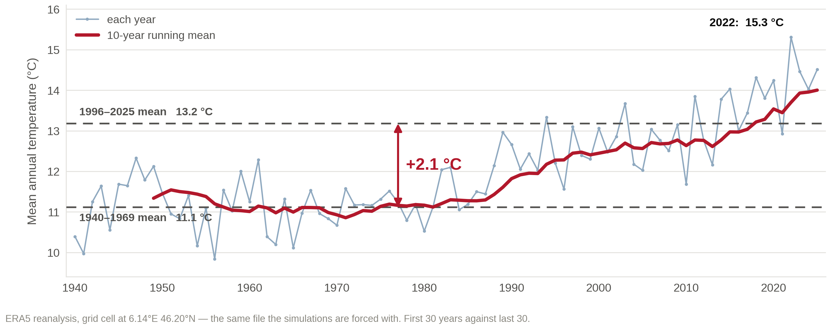
Geneva is 2.1 °C warmer than it was

